Slide 1
Predictive Modelling/Analytics

Slide 2
Predictive Analytics
Predictive Analytics: Use statistics and modeling techniques to make predictions about future outcomes
Types: Regression and Classification
Common types: Linear regression, Logistic regression, Decision trees, Random forest, Neural networks, Time series forecasting, K Nearest Neighbors (KNN), Naïve Bayes, Clustering

Slide 3
Regression
Regression: Predict a dependent variable (target) using independent variable(s) (features/predictors)
y: Dependent numeric variable
X: Independent variable(s)
We know X and we want to predict y
Linear regression: y is numeric
Logistic regression: y is categorical

Slide 4
Regression and Classification
Regression: Numeric target, Classification: Class target
Regression examples | Classification examples
How many page views will we get? | Is this a fraudulent transaction?
What will be the amount of loss? | Whose face is in this picture?
What will be the blood sugar level? | Which product is best fit for the customer?

Slide 5
Confusion About Regression
Predictive Analytics
Numeric
Categorical
Regression
Classification
Linear Regression
Logistic Regression
Decision Trees
Naïve Bayes’ Classifier

Slide 6
Main Types of Regression
Simple Linear Regression: Relationship between the independent variable and the dependent variable is linear (Taxi milage -> Bill amount)
Multiple Linear Regression: More than one independent variable – Also called multivariate analysis (Years of Work Experience + Education Level -> Salary)
Logistic Regression: Binary classification problems (Customer Tenure + Monthly Subscription Cost + Customer Complaints -> Churn?)

Slide 7
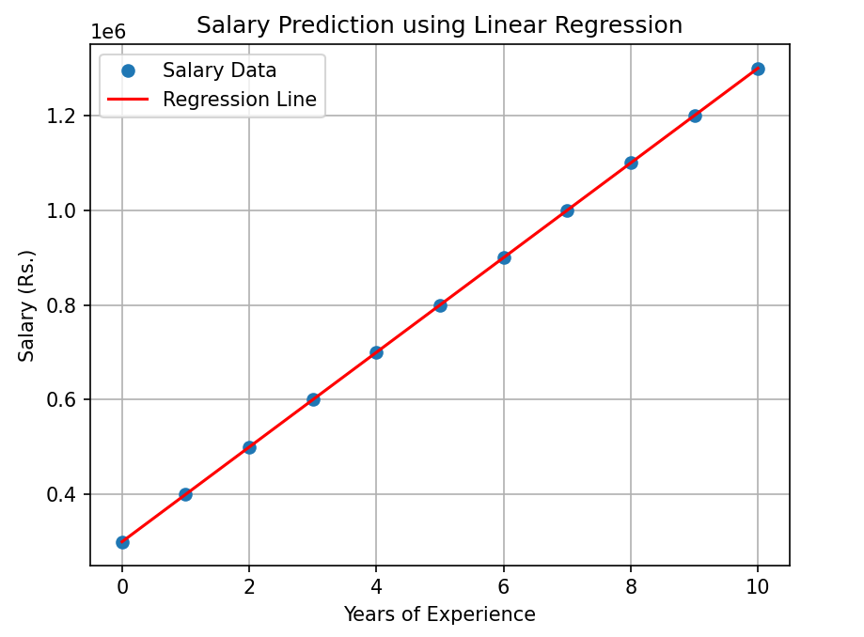
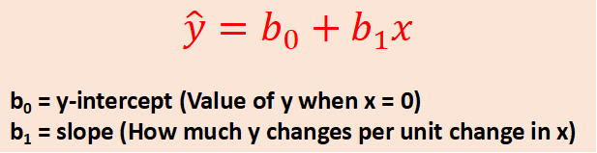
Linear Regression
Example:
Salary (y) = 3,00,000 + 1,00,000x
Here, b₀ = 3,00,000 and b₁ = 1,00,000
Experience (Years) | Salary (Rupees in Lakhs)
0 | 3
1 | 4
2 | 5
3 | 6
4 | 7
5 | 8
6 | 9
7 | 10
8 | 11
9 | 12
10 | 13
$$\hat{y}=b_{0}+b_{1}x$$
b₀ = y-intercept (Value of y when x = 0)
b₁ = slope (How much y changes per unit change in x)

Slide 8
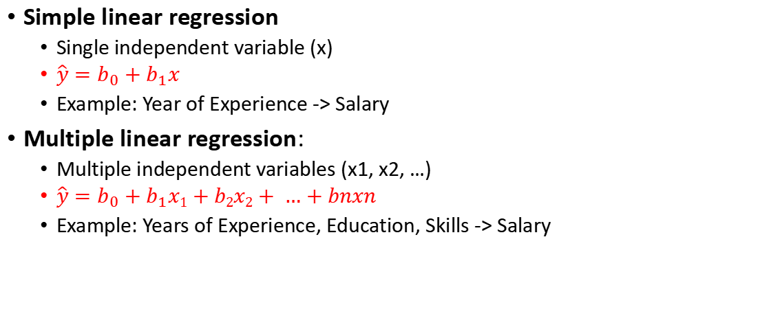
Simple and Multiple Linear Regression
Simple linear regression
Single independent variable (x)
$\hat{y}=b_{0}+b_{1}x$
Example: Year of Experience -> Salary
Multiple linear regression:
Multiple independent variables (x1, x2, …)
$\hat{y}=b_{0}+b_{1}x1+b2x2+ …+bnxn$
Example: Years of Experience, Education, Skills -> Salary

Slide 9
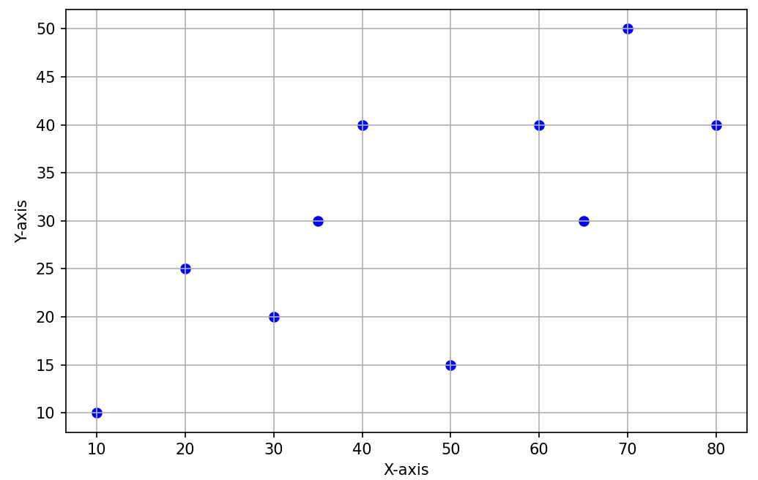
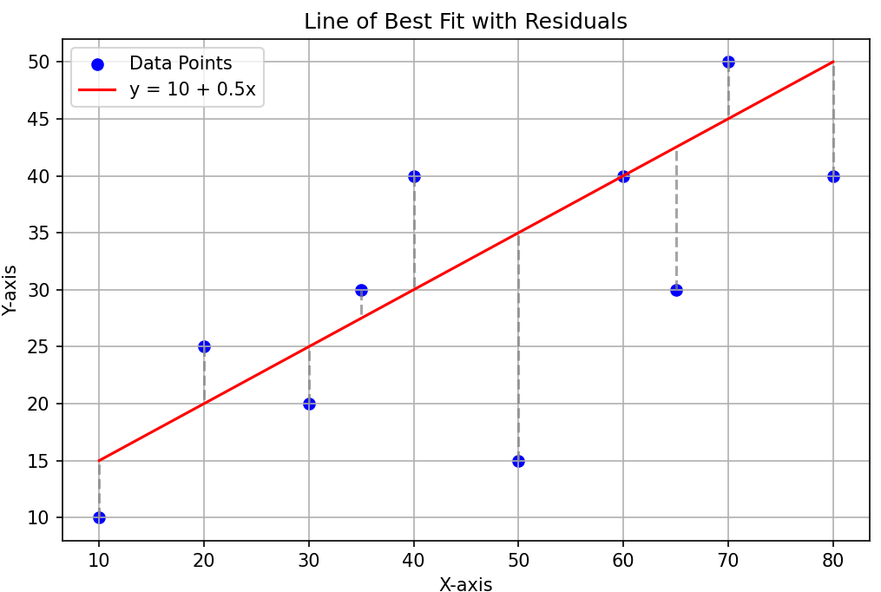
Least Squared Error
Suppose our line satisfies the equation y = 10 + 0.5x
x | y (Actual) | y (Line) | Error | Squared Error
10 | 10 | 15 | 5 | 25
20 | 25 | 20 | -5 | 25
30 | 20 | 25 | 5 | 25
35 | 30 | 27.5 | -2.5 | 6.25
40 | 40 | 30 | -10 | 100
50 | 15 | 35 | 20 | 400
60 | 40 | 40 | 0 | 0
65 | 30 | 42.5 | 12.5 | 156.25
70 | 50 | 45 | -5 | 25
80 | 40 | 50 | 10 | 100
Sum of Squared Error (SSE) |  |  |  | 862.5

Slide 10
Least Squared Error
Repeat this process with different lines and calculate Sum of Squared Error (SSE)
Line of best fit = Line where we get the smallest SSE
Problem: We cannot do this ourselves
Solution: Use machine learning

Slide 11
Interpreting Results (Formulae: Next Slide)
MAE: Is not impacted by large outliers
RMSE: Is impacted by large outliers (Since it is based on MSE, which is impacted by large outliers)
R-squared (R²)
A percentage that tells us how much of the variance in data is explained by our model
Example: R-squared = 90.27% for an example where we predict a person’s weight based on the height means that this much of variance is covered by our model
The higher the better (Calculation on the next slide)
Mean Absolute Error (MAE)
By how many units is the model prediction different from the actual values
Lower the better
Mean Squared Error (MSE)
Amplifies outliers, does not tell use about the direction of the errors because of squaring
Lower the better
Root Mean Squared Error (RMSE)
Square root of MSE, so it is in the unit of the target variable – Easier to interpret
Lower the better
These three explain how well the model predicts, not how it explains variance

Slide 12
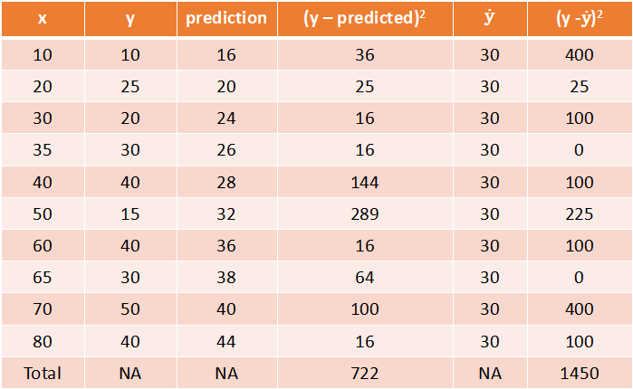

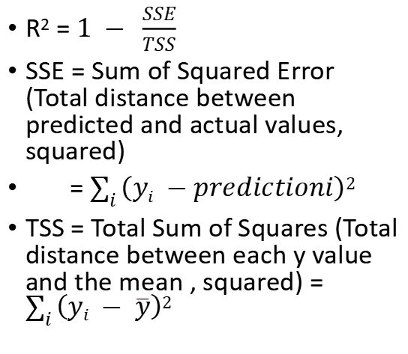
R-Squared Calculation
x | y | prediction | (y – predicted)² | $$\text{ẏ}$$ | (y -$\text{ẏ}$)²
10 | 10 | 16 | 36 | 30 | 400
20 | 25 | 20 | 25 | 30 | 25
30 | 20 | 24 | 16 | 30 | 100
35 | 30 | 26 | 16 | 30 | 0
40 | 40 | 28 | 144 | 30 | 100
50 | 15 | 32 | 289 | 30 | 225
60 | 40 | 36 | 16 | 30 | 100
65 | 30 | 38 | 64 | 30 | 0
70 | 50 | 40 | 100 | 30 | 400
80 | 40 | 44 | 16 | 30 | 100
Total | NA | NA | 722 | NA | 1450
R² = $1 − \frac{SSE}{TSS}$
SSE = Sum of Squared Error (Total distance between predicted and actual values, squared)
= $\sum_{i}{\left(yi −predictioni\right)2}$
TSS = Total Sum of Squares (Total distance between each y value and the mean , squared) = $\sum_{i}{\left(yi − \overline{y}\right)2}$
R² = $1 − \frac{SSE}{TSS}$
= $1 − \frac{722}{1450}$ = 0.502

Slide 13
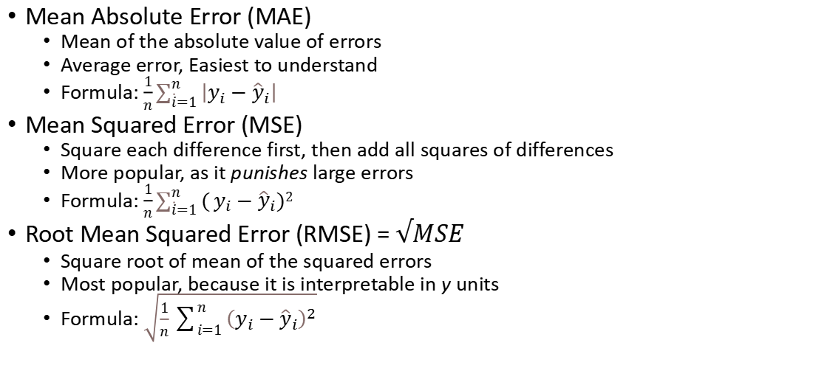
Evaluation Metrics for Linear Regression
All these are called Loss functions, because we want to minimize them
Mean Absolute Error (MAE)
Mean of the absolute value of errors
Average error, Easiest to understand
Formula: $\frac{1}{n}\sum_{\dot{i}=1}^{n}{\left|y_{i}−{\hat{y}}_{i}\right|}$
Mean Squared Error (MSE)
Square each difference first, then add all squares of differences
More popular, as it punishes large errors
Formula: $\frac{1}{n}\sum_{\dot{i}=1}^{n}{(}y_{i}−{\hat{y}}_{i})2$
Root Mean Squared Error (RMSE) = $√MSE$
Square root of mean of the squared errors
Most popular, because it is interpretable in y units
Formula: $\sqrt{\frac{1}{n}\sum_{i=1}^{n}{{\left(y_{i}−{\hat{y}}_{i}\right)}^{2}}}$
In height-weight example:
R-squared: 90 … Good
MAE: 8 pounds
MSE: 101
RMSE: 10 pounds
(Average weight in the dataset is 161 pounds, so RMSE is 6% of the average, which is good)

Slide 14
Linear Regression: Python Implementations
LinearRegression() | OLS()
Part of scikit-learn | Part of statsmodels
Mainly used for machine learning tasks | Mainly used for statistical analysis
Focus on predictive modelling | Focus on understanding relationships between variables
Less focus on statistical details | Provides detailed statistics
Includes intercept by default | Need to add intercept using sm.add_constant()
Focus on metrics such as MSE, R² etc | Focus on coefficients, t-statistics (e.g. is there a linear relationship between a feature and the predicted variable?), p-value, CI*
*Example: Predictor (Feature): X1, Coefficient (beta): 2.5, Standard Error (SE) = 0.5, t-statistic = 5, p-value = 0.0001
t-statistic = 2.5 / 0.5 = 5 … The predictor (feature) X1 is 5 SEs away from 0
P-value = 0.0001 … There is only a 0.01% chance of observing such a t-statistic if the true coefficient of X1 = 0
Since p-value < 0.05, we reject H0 … X1 significantly affects Y (H0: X has no linear relationship with y)

Slide 15
Scaling and Encoding

Slide 16
Scaling and Encoding
Predictive analytics: Use one or more features (e.g. Years of experience) to predict a label (Salary)
Problem: (1)Scales of numeric coloumns are diffrent
(2) Machine Learning can work only with numeric data
Solution: Scaling and Encoding
Scaling: Converting numeric features to a common scale
Example: Age (0-100) and income ($0-$1 million)
Encoding: Converting categorical variables to a numeric scale
Example: Gender values of Male and Female

Slide 17
Scaling: Bring Numeric Data on a Common Scale
Scaling: Putting all the features on the same ruler/scale
Standardization/Normalization: Subtracts the mean and divides by the standard deviation
Min-max scaling: Scales to a specific range based on the minimum and maximum values
Scaling
Standardization/Normalization
Min/Max Scaling

Slide 18
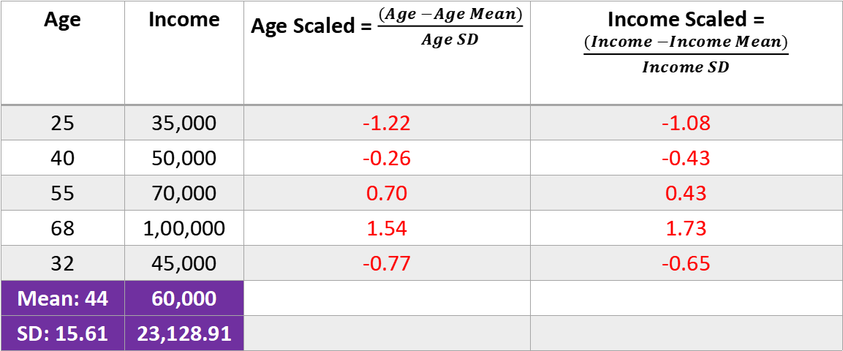
Standardized Scaling (Normalized Scaling)
Age | Income | Age Scaled = $\frac{(Age −Age Mean)}{Age SD}$ | Income Scaled = $\frac{(Income −Income Mean)}{Income SD}$
25 | 35,000 | -1.22 | -1.08
40 | 50,000 | -0.26 | -0.43
55 | 70,000 | 0.70 | 0.43
68 | 1,00,000 | 1.54 | 1.73
32 | 45,000 | -0.77 | -0.65
Mean: 44 | 60,000
SD: 15.61 | 23,128.91

Slide 19
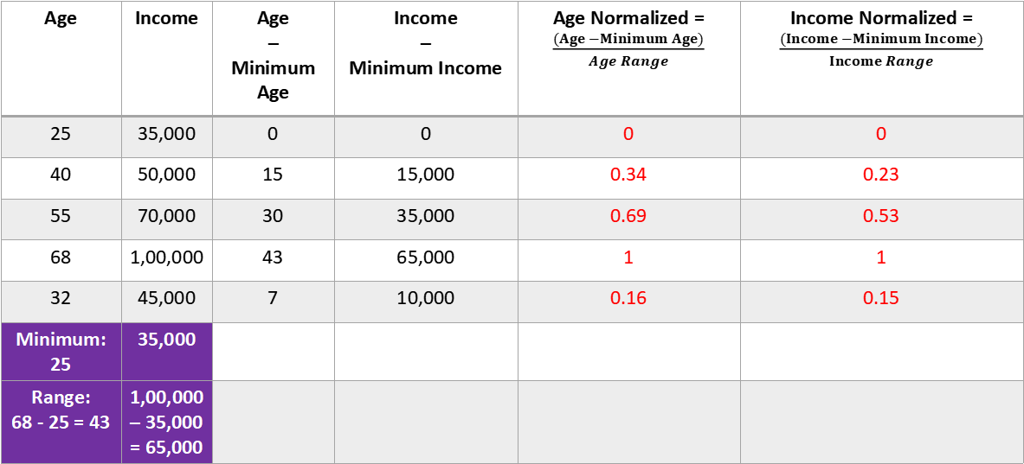
Min-Max Scaling
Because we use range also, it is called min-max (both get used)
Age | Income | Age – Minimum Age | Income – Minimum Income | Age Normalized = $\frac{(Age −Minimum Age)}{Age Range}$ | Income Normalized = $\frac{(Income −Minimum Income)}{Income Range}$
25 | 35,000 | 0 | 0 | 0 | 0
40 | 50,000 | 15 | 15,000 | 0.34 | 0.23
55 | 70,000 | 30 | 35,000 | 0.69 | 0.53
68 | 1,00,000 | 43 | 65,000 | 1 | 1
32 | 45,000 | 7 | 10,000 | 0.16 | 0.15
Minimum: 25 | 35,000
Range: 68 - 25 = 43 | 1,00,000 – 35,000 = 65,000

Slide 20
Working with Non-Numeric Features – Encoding
Encoding: Transform categorical data into a numeric form (e.g. Passenger Class: Business, has 20% travellers, Economy Plus, has 30% travellers, Economy, has 50% travellers)
One-Hot Encoding: Business = 100, Economy Plus = 010, Economy = 001
Label Encoding: Business = 0, Economy Plus = 1, Economy = 2
Frequency encoding: Business = 0.20, Economy Plus = 0.30, Economy = 0.50
Encoding
One-Hot Encoding
Label Encoding
Frequency Encoding

Slide 21
One-Hot Encoding: Columns
One-Hot encoding adds a column per category
Example: Dataset before and after One-Hot encoding
Computer | OS
PC-01 | Windows
PC-02 | Linux
PC-03 | Linux
PC-04 | Linux
PC-05 | Windows
PC-06 | Mac
Computer | OHE (Windows) | OHE (Linux) | OHE (Mac)
PC-01 | 1 | 0 | 0
PC-02 | 0 | 1 | 0
PC-03 | 0 | 1 | 0
PC-04 | 0 | 1 | 0
PC-05 | 1 | 0 | 0
PC-06 | 0 | 0 | 1

Slide 22
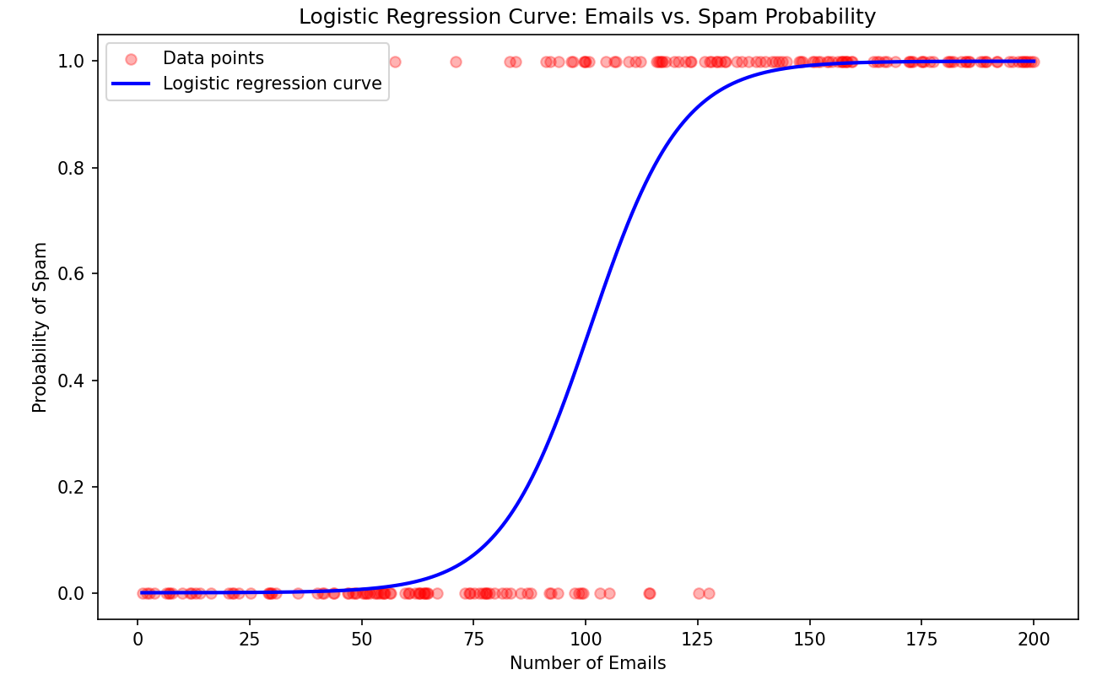
Logistic Regression
Logistic regression: Classification technique to predict the probability of a binary (true/false) outcome
Forms an S-shaped curve between 0 and 1

Slide 23
Confusion Matrix
Test to check if patients have a disease (H₀: Patient does not have a disease)
True Positive (TP) Prediction: Disease Reality: Disease
True Negative (TN) Prediction: No Disease Reality: No Disease
False Positive (FP) Prediction: Disease Reality: No Disease
False Negative (FP) Prediction: No Disease Reality: Disease
n = 165 | Predicted: NO | Predicted: YES
Actual: NO | TN = 50 | FP = 10 (Type I Error)
Actual: YES | FN = 5 (Type II Error) | TP = 100

Slide 24
Confusion Matrix - Exercise
Out of 1000 emails, 800 non-spams were classified correctly, 20 were incorrectly classified as spam, 40 were incorrectly classified as non-spam, and the remaining spams were identified correctly
Write the null hypothesis and create a confusion matrix

Slide 25
Confusion Matrix - Exercise
Out of 1000 emails, 800 non-spams were classified correctly, 20 were incorrectly classified as spam, 40 were incorrectly classified as non-spam, and the remaining spams were identified correctly
Write the null hypothesis and create a confusion matrix
H₀: Email is not spam
n = 1000 | Predicted: NO | Predicted: YES
Actual: NO | TN = 800 | FP = 20 (Type I Error)
Actual: YES | FN = 40 (Type II Error) | TP = 140

Slide 26
Metrics Derived from Confusion Matrix
Accuracy: Overall correctness of the model's predictions
Precision (Positive Predictive Value): Accuracy of positive predictions
Recall (Sensitivity or True Positive Rate): Ability of the model to identify all positive instances
Specificity (True Negative Rate): Ability of the model to identify all negative instances
F1 Score: Harmonic mean of precision and recall and provides a balance between the two metrics

Slide 27
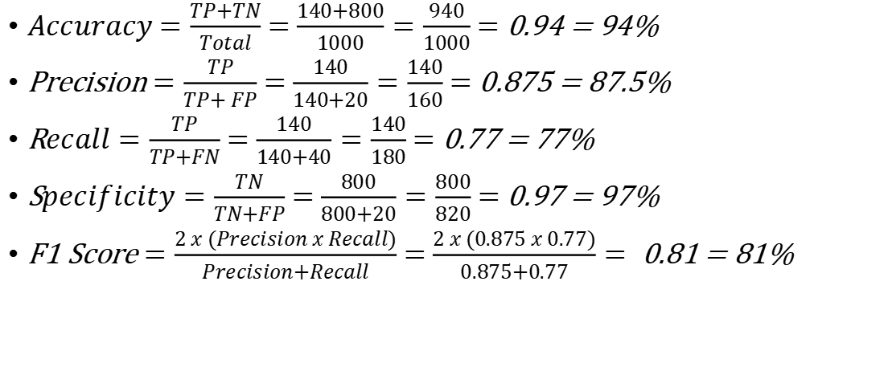
Metrics for Our Example
$Accuracy$ $=\frac{TP+TN}{Total}$ $=$ $\frac{140+800}{1000}=\frac{940}{1000}$ $=$ 0.94 = 94%
Precision $=\frac{TP}{TP+ FP}$ $=$ $\frac{140}{140+20}=\frac{140}{160}$ $=$ 0.875 = 87.5%
R$ecall=\frac{TP}{TP+FN}$ $=$ $\frac{140}{140+40}=\frac{140}{180}$ $=$ 0.77 = 77%
S$pecificity=\frac{TN}{TN+FP}$ $=$ $\frac{800}{800+20}=\frac{800}{820}$ $=$ 0.97 = 97%
F1 Score $=\frac{2 x (Precision x Recall)}{Precision+Recall}$ $=$ $\frac{2 x (0.875 x 0.77)}{0.875+0.77}=$0.81 = 81%

